Slide 1
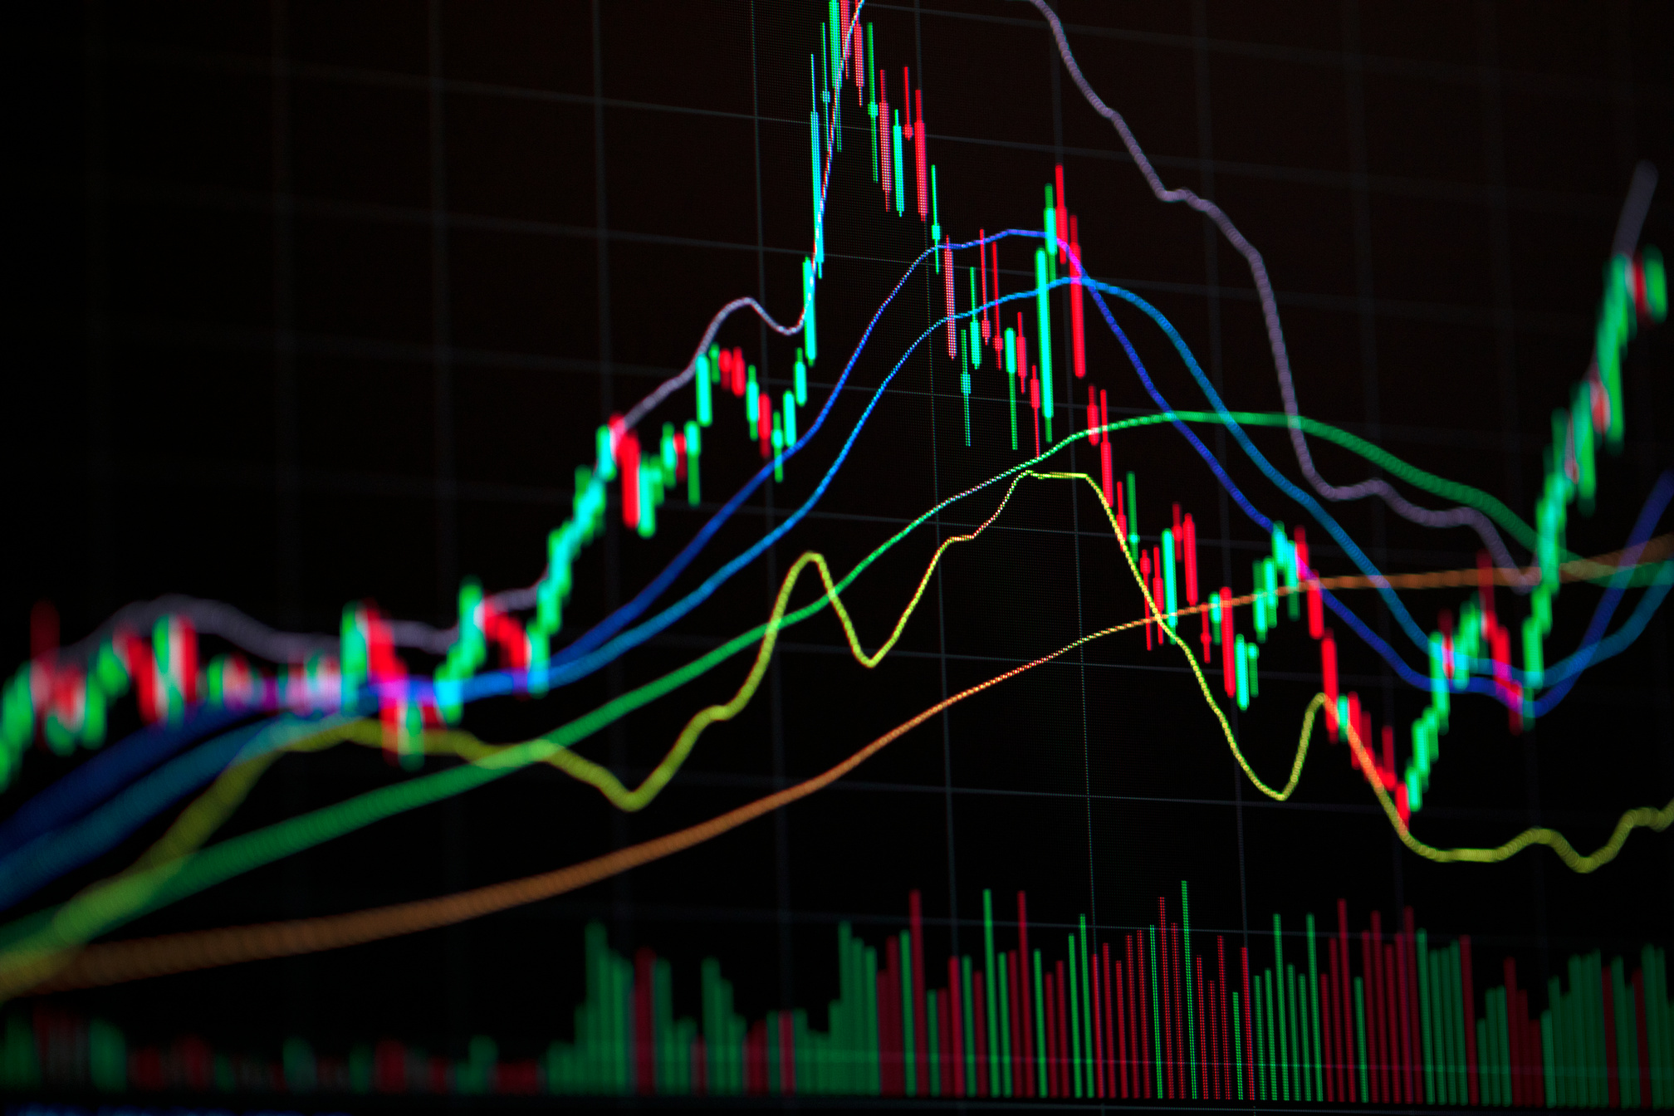




Stock Market
Welcome to our Presentation on
FOREIGN DIRECT INVESTMENT
Govt. G. N. A. P. G. College, Bhatapara(c.g.)

Slide 2

Group 13
Members
S.N. Name of Student
181 SAKSHI NIRMALKAR
182. SAKSHI SAHU
183. SAKSHI SHARMA
184 SAMEER VERMA
185. SAMIR SAHU
186 SAMRIDHEE CHAURIYA
187 SANDHYA
188 SANDHYA SAHU
189. SANDHYA SAO
190. SANJU SAHU
191. SARITA BAGHEL
192. SATYAPRAKASH GHRITLAHARE
193. SATYAPRAKASH KURREY
194. SAURABH SINGH RAJPUT
195. SAURABH VERMA

Slide 3

INDEX
• Introduction to FDI
• Types of FDI
• Greenfield vs. Brownfield
• Methods of FDI
• Motives for FDI
• Benefits of FDI
• Drawbacks of FDI
• Global FDI Trends
• FDI in Developing Countries
• Regulatory Framework
• Case Studies
• FDI vs. Foreign Portfolio Investment
• Strategic Considerations
• Conclusion
• References & Q&A

Slide 4

Introduction to FDI
Foreign Direct Investment refers to a situation where a company or individual from one country invests directly into business operations or assets in another country. FDI is characterized by the investor having substantial control—usually defined as owning at least 10% of the foreign enterprise's shares or voting power. This investment typically aims at establishing a lasting interest and influence over management decisions in the foreign country.

Slide 5

Types of FDI
Horizontal FDI
Investment in the same industry
as the investor operates at home
(e.g., Coca-Cola building bottling
plants abroad).
Vertical FDI
Investment in different but related industries, often as part of the supply chain (e.g., car manufacturer investing in parts suppliers abroad).
Conglomerate FDI
Investment in an unrelated industry overseas.
Platform FDI
Investments in one country as a base
to export to another country.

Slide 6


Greenfield and Brownfield Investments
Greenfield Investment:
Building entirely new facilities or businesses in the foreign country, such as Tesla constructing a Gigafactory.
Brownfield Investment:
Acquiring or merging with existing foreign businesses or assets, such as Vodafone acquiring an Indian telecom firm.

Slide 7


Methods of FDI
• Wholly Owned Subsidiaries: Setting up a new business fully owned by the investor.
• Joint Ventures: Partnering with local firms to share ownership and risks.
• Mergers & Acquisitions: Taking control of or merging with an existing foreign enterprise.

Slide 8

Methods of FDI
• Wholly Owned Subsidiaries: Setting up a new business fully owned by the investor.
• Joint Ventures: Partnering with local firms to share ownership and risks.
• Mergers & Acquisitions: Taking control of or merging with an existing foreign enterprise.

Slide 9

Motives for FDI
• Resource Seeking: Access natural resources or raw materials.
• Market Seeking: Enter new or large markets to increase sales and growth.
• Efficiency Seeking: Optimize production costs via favorable labor or logistics.
• Strategic Asset Seeking: Acquire advanced technology, brands, or distribution networks.

Slide 10
BENEFITS OF FDI
• Creates new jobs and skill development in the host country.
• Facilitates technology and knowledge transfer.
• Boosts infrastructure and economic growth.
• Increases exports and integration into global supply chains.

Slide 11

Salford & Co.
Drawbacks of FDI
• Possible loss of control over key sectors in the host country.
• Can drive domestic businesses out of the market.
• Social and environmental impacts, including cultural shifts and pollution.

Slide 12



Global FDI Trends
• Over the past 30 years, global FDI flows and stocks have grown rapidly.
• Major host countries include the United States, China, Singapore, and India.
• Recent years have seen emerging markets become significant recipients of FDI.

Slide 13


FDI in Developing Countries
• Developing nations attract FDI for their large markets or low labor costs.
• Case example: India has seen major FDI inflows in the and retail sector (e.g., Walmart, Apple manufacturing units).
• FDI aids infrastructure, jobs, and technology, but can generate controversy over market dominance or profit repatriation.

Slide 14

Regulatory Framework
• Countries have set laws and regulations to oversee foreign investment, including sectoral restrictions and approval processes.
• In India, FDI can be routed via the automatic route (no government approval needed) or government route (approval required for certain sectors).
• Policy stability is key for attracting sustainable FDI.

Slide 15
Case Studies
• Walmart & Flipkart: US giant Walmart invested billions to acquire Flipkart, revolutionizing Indian e-commerce.
• Tesla in Germany: Example of a Greenfield investment, building new manufacturing capacity in Europe.
• Apple’s India Expansion: Apple began assembling phones for the Indian market, combining market seeking and efficiency motives.

Slide 16
FDI VS. FOREIGN PORTFOLIO INVESTMENT (FPI)
• FDI involves direct control/ownership, typically for long-term strategic interests.
• FDI refers to investments in financial assets like stocks and bonds, without direct management or long-term control.

Slide 17
Conclusion and Q&A
• FDI is crucial for global economic integration, technology diffusion, and development.
• Policymakers must create favorable conditions for responsible, mutually beneficial FDI.

Slide 18

THANK YOU
FOR YOUR ATTENTION

